Slide 1
What Factors Predict Flight Activity?
Sadie Harper
DSC500-T301
Bellevue University
2/14/2021
Looking at factors that might lead to increased flights during and after a pandemic in the United States

Slide 2
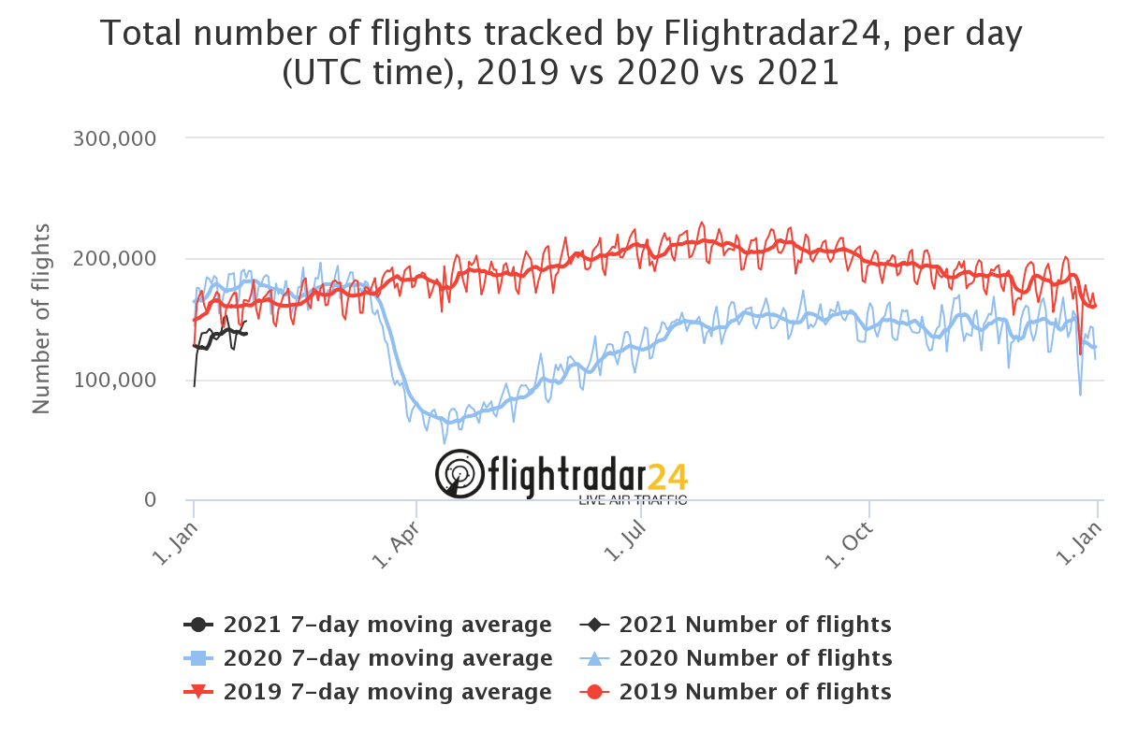
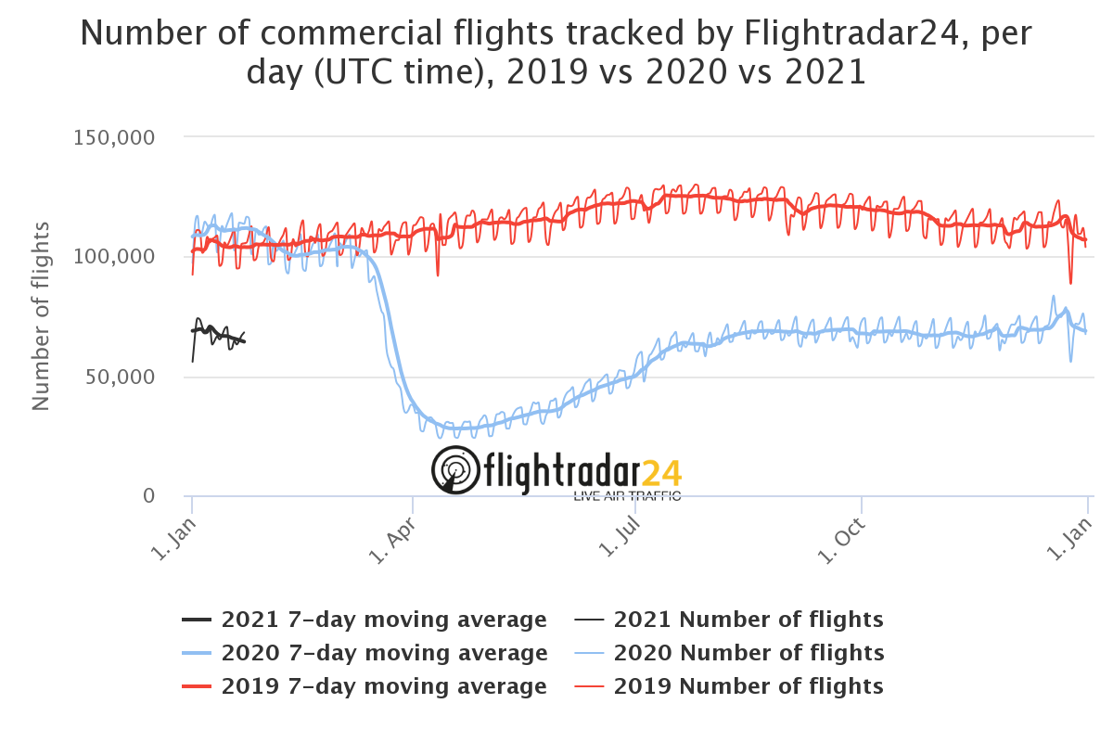
Flight Activity Baseline
Total number of flights includes all operation types
Commercial
Personal
Charter
Fractional
Cargo
Number of commercial flights relates to the big airline companies, for example:
United
American
Delta
Southwest
Flights are down during the pandemic – but what are the underlying factors bringing them back up?
Commercial flights are still down in 2021 but total number of flights are much higher which indicates that noncommercial flying just might be starting to rise to pre-pandemic numbers

Slide 3
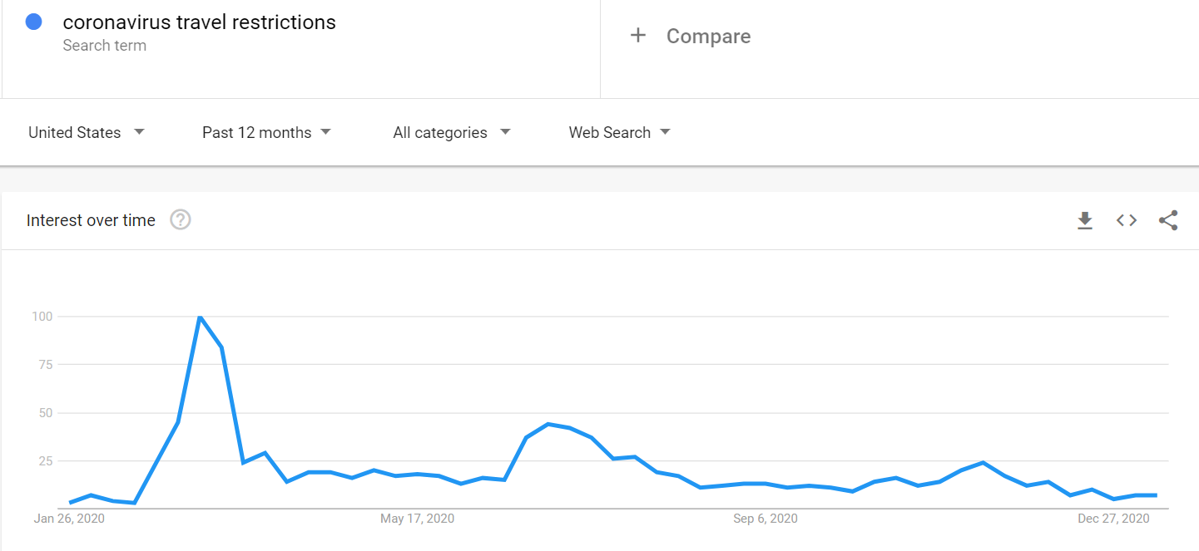
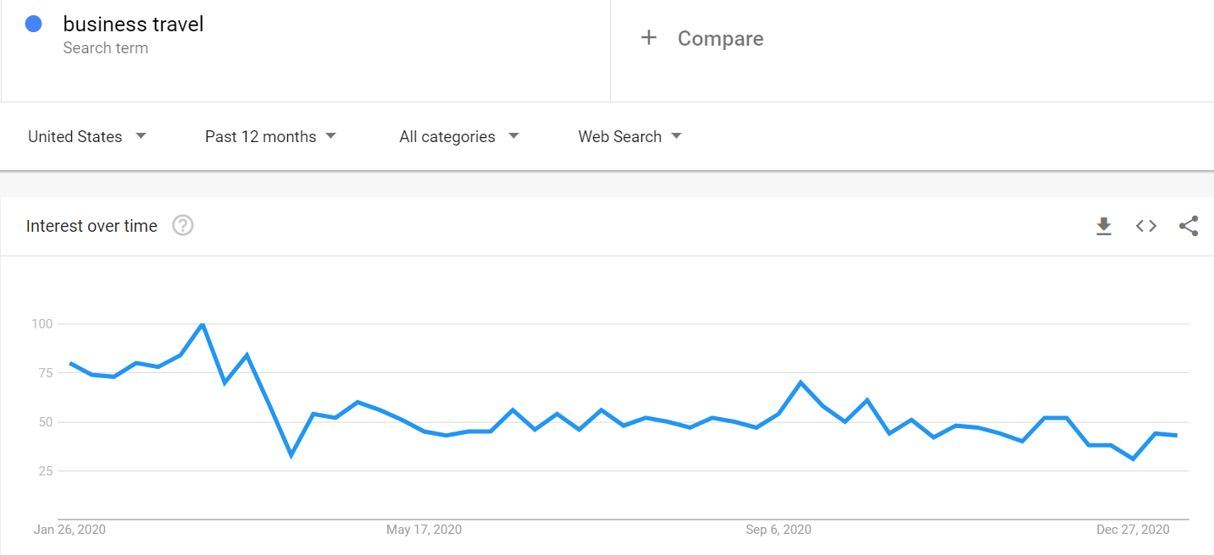
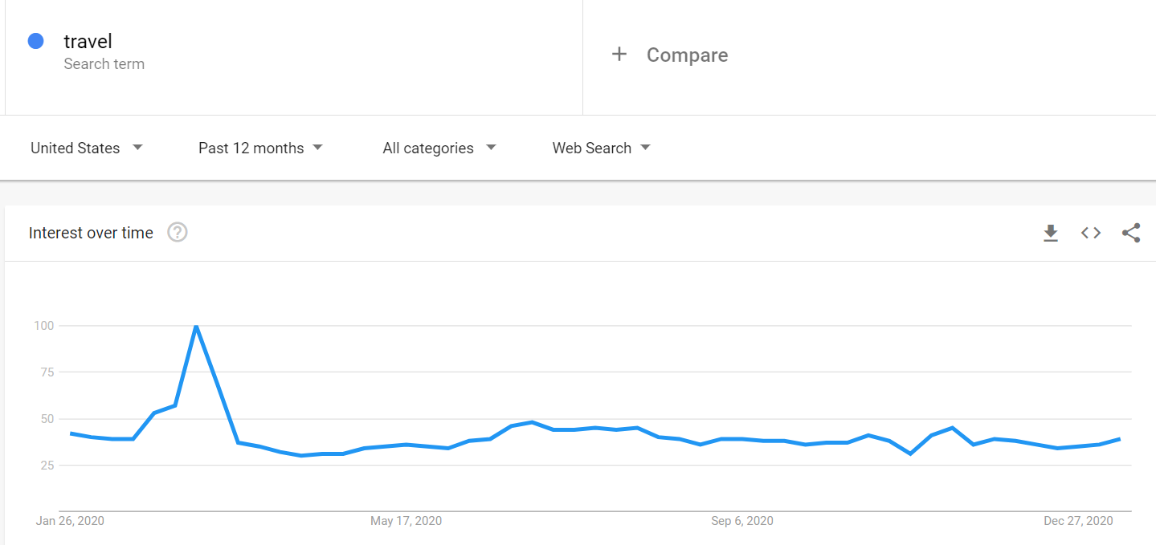
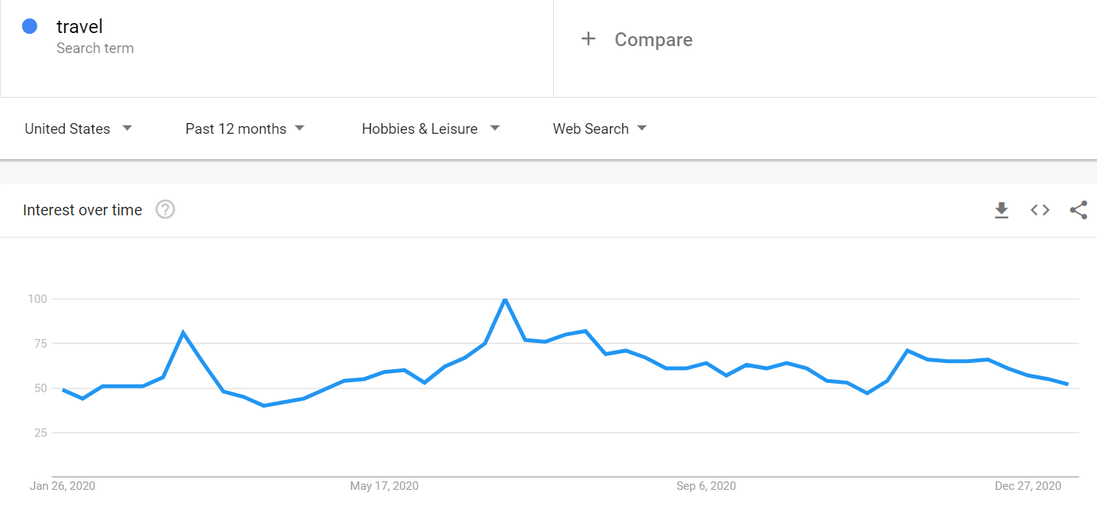
Travel Searches
All the searches pictured can see a spike in the beginning of 2020 which shows a negative correlation to the significant drop in flights during that that time
Coronavirus travel restrictions seem to be less of a concern later in the year as flying starts to pick back up
Business travel had less of a spike during early March than the other searches did, but it more slowly died down
Travel in hobbies & leisure also seem to stay somewhat high and they have a second spike during the summer months that is not reflected in the flight data
General travel searches became much less relevant as the year went on
It seems that searching for specific types of travel could be an indicator in flight activity in the noncommercial sector
It is important to note that travel related searches could represent any form of travel, but I am focusing on what the general feeling was about traveling during this time
With travel searches I would focus on business and personal travel separately to try to prove that interest in certain forms of travel means an increase in flight activity – I assume business travel is more likely to pick back up first

Slide 4
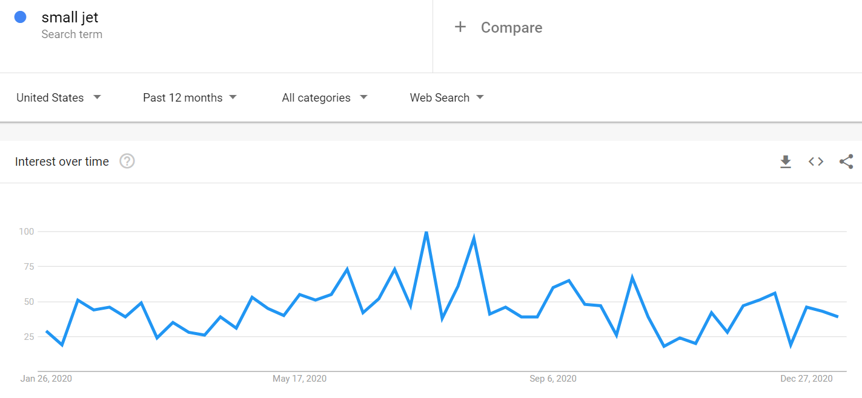
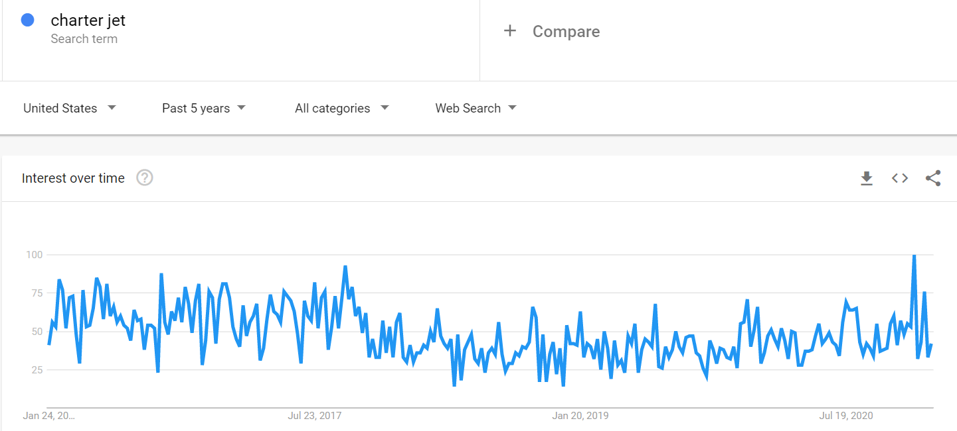
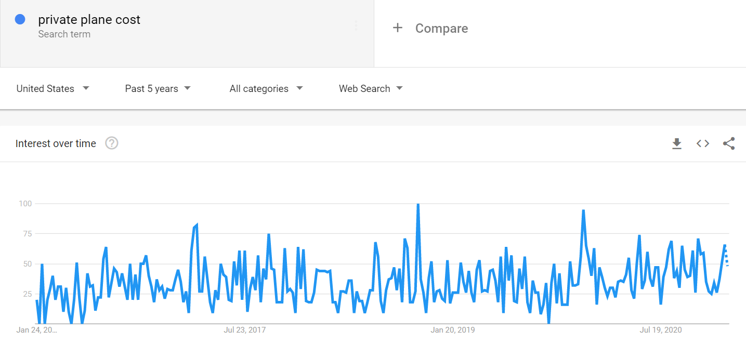
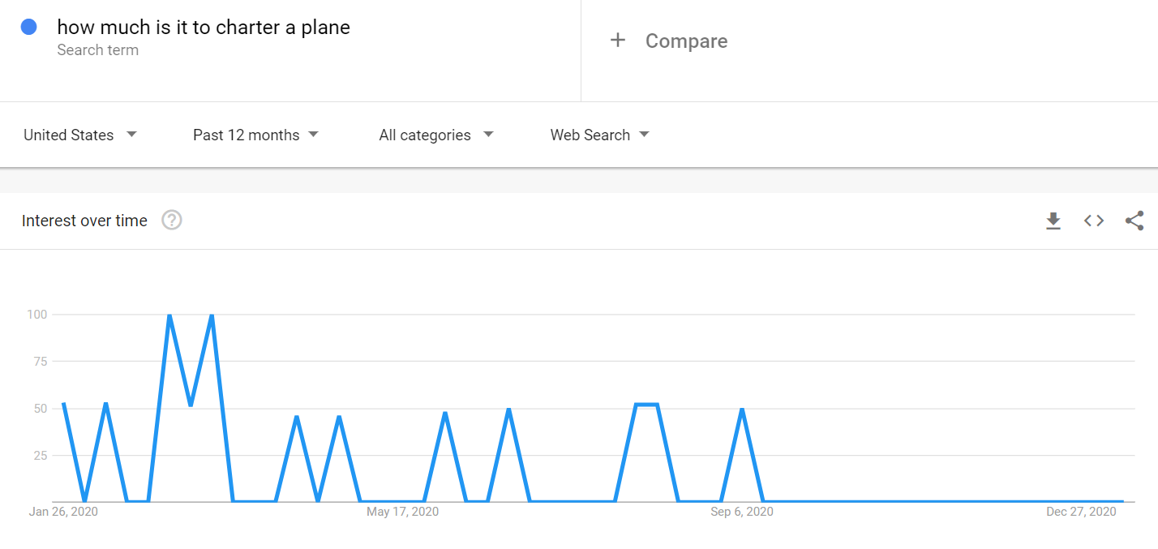
Noncommercial Searches
In order to investigate noncommercial travel, I focused this round of searches on charter and small jet related topics
Small jet started to spike a bit in the middle of the year – maybe people realized commercial flights weren't coming back and so they started having questions around other methods of air travel
The cost of private planes also slightly increases in 2020 which could mean an increased interest – I included the past 5 years to be sure the increase was there
Charter jet searches were higher 5 years ago, then dropped, but have clearly started to jump back up – charter travel can come across much safer than commercial airlines so this increase could mean people are looking for those alternative flying methods
Google listed “how much is it to charter a plane” as a breakout search during my charter searches and it is high early in 2020 so as the pandemic really hit the US people started to investigate other forms of air travel
I think that this search data does possibly indicate an increase in people wondering more about personal jets and using charter companies for air travel – which could explain why there seems to be a higher number of noncommercial flights
In recent news – a private charter aviation company, Wheels Up, is going public and their CEO thinks the interest for this form of travel is going to increase after the pandemic
With noncommercial searches I would focus on charter services and private jets to try to prove that an increase in these topics also mean an increase in noncommercial flight activity because I assume this will be true and I think the interest is there

Slide 5
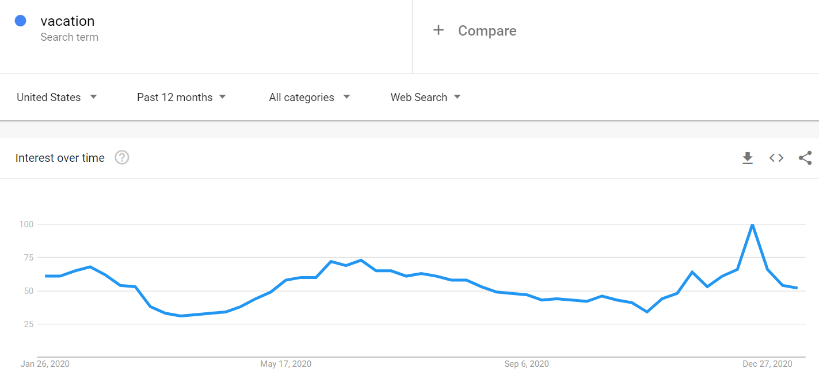
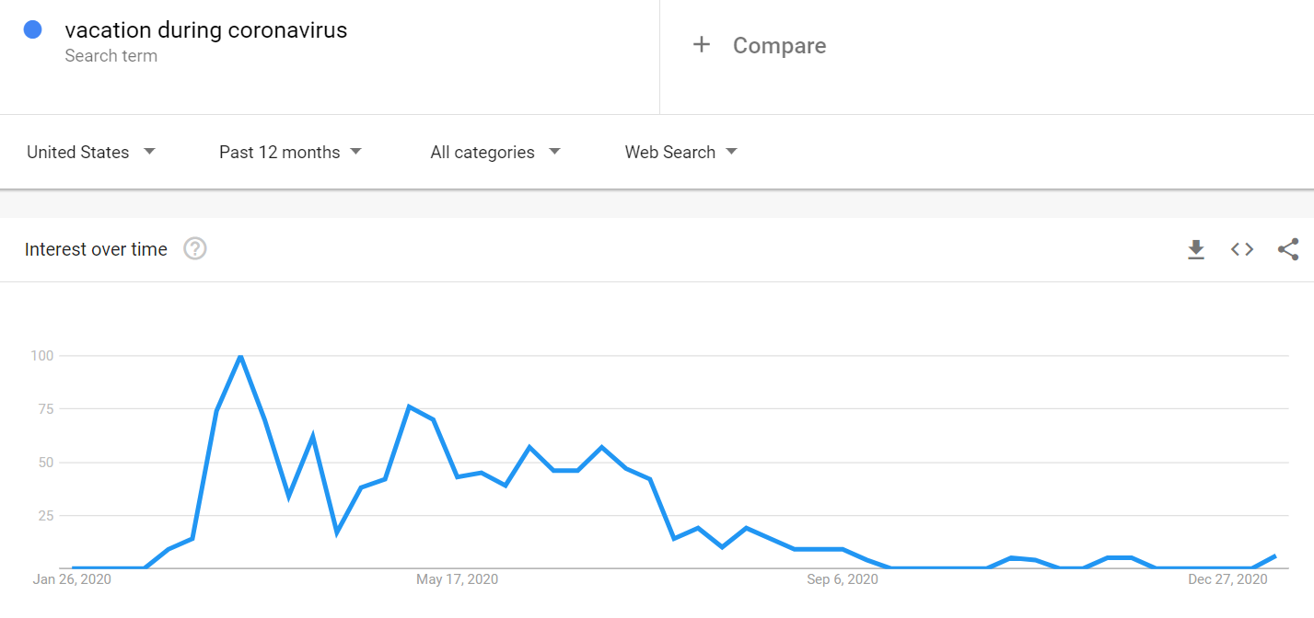
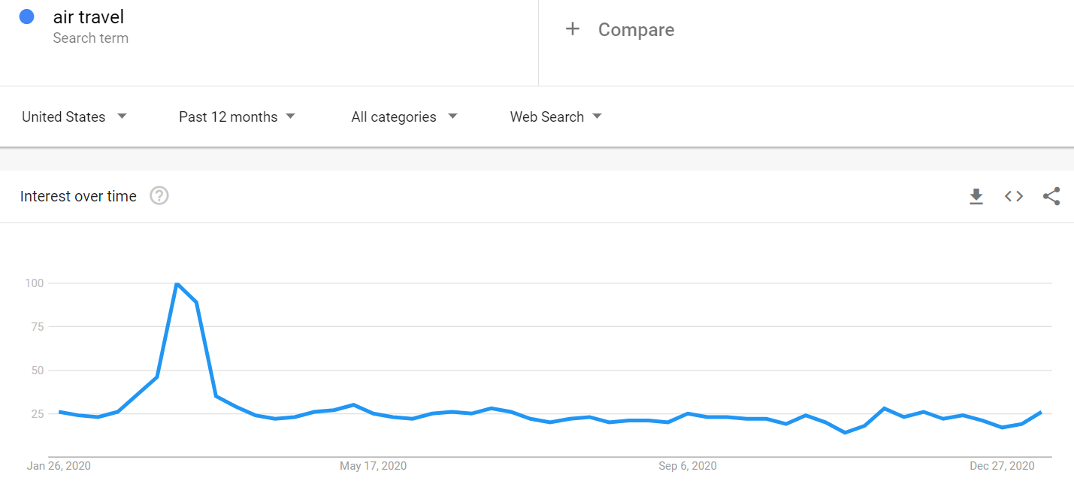
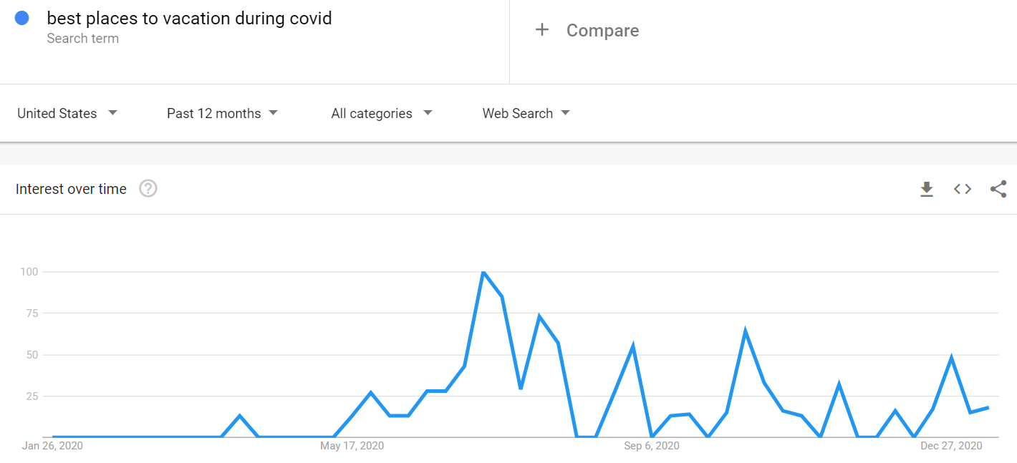
Vacation & Leisure Searches
For this section I wanted to focus on vacation and leisure because this form of travel most likely falls more dependent on commercial airlines
Searches for vacation dropped a bit during the beginning of the pandemic and as lockdowns happened but vacation during coronavirus shot up during that time – maybe people were trying to figure out what options they had
People were searching for air travel quite a bit in early 2020 – probably trying to figure out if it was possible to travel since the shutdowns started around that time
It is interesting to me that “best places to vacation during covid” was more popular after the lockdowns started to let up later in the year
This could mean that people are trying to get back out there
This looks to correlate a bit with how commercial flying started to pick back up at the end of 2020 as seen earlier
With vacation & leisure searches I would focus on where people are searching for travel to determine if that requires flying as well as comparing this data more to commercial flight activity specifically because I assume that finding more about where people want to travel could provide a lot of insight

Slide 6
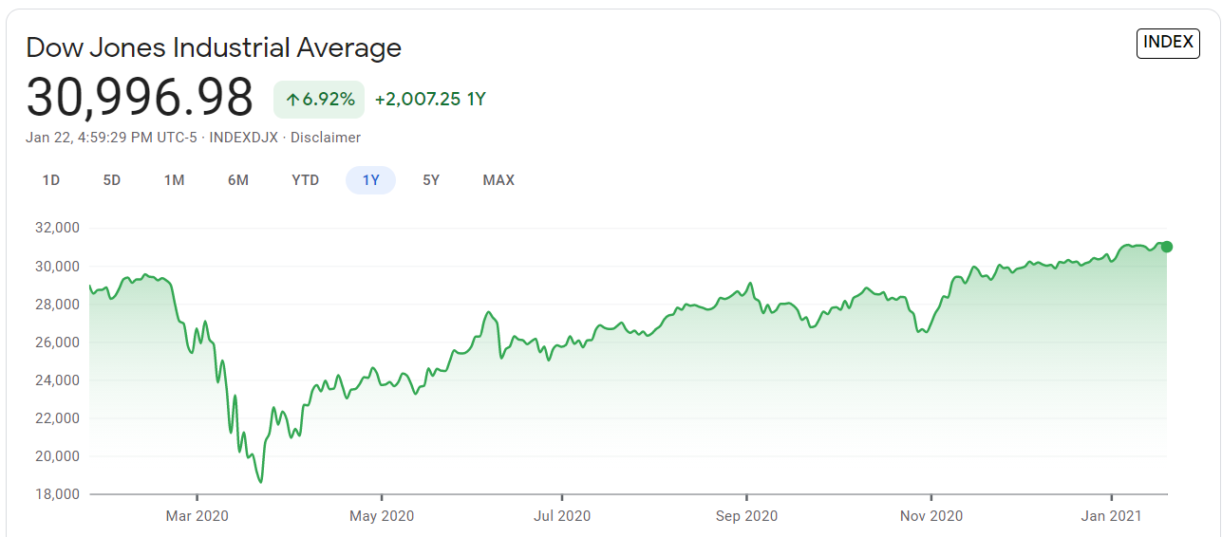
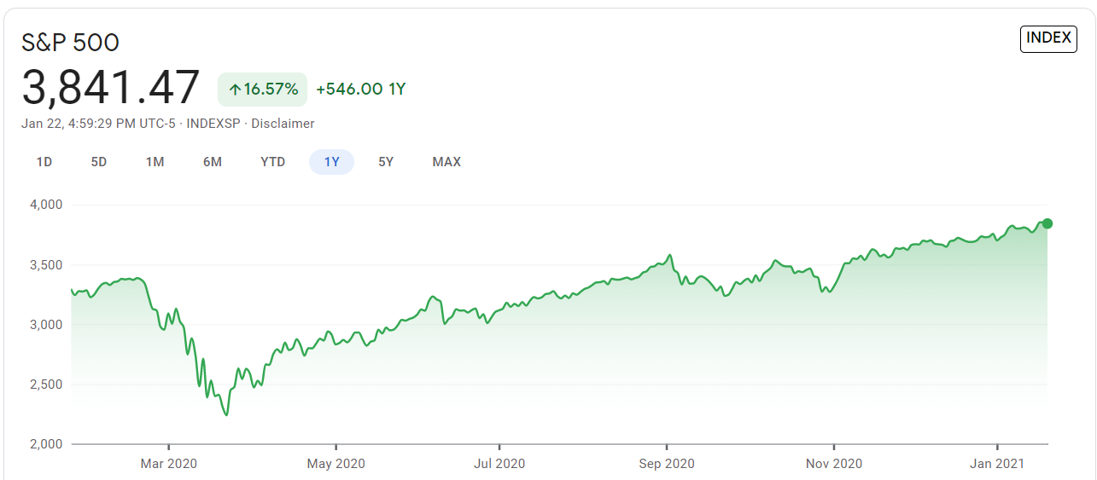
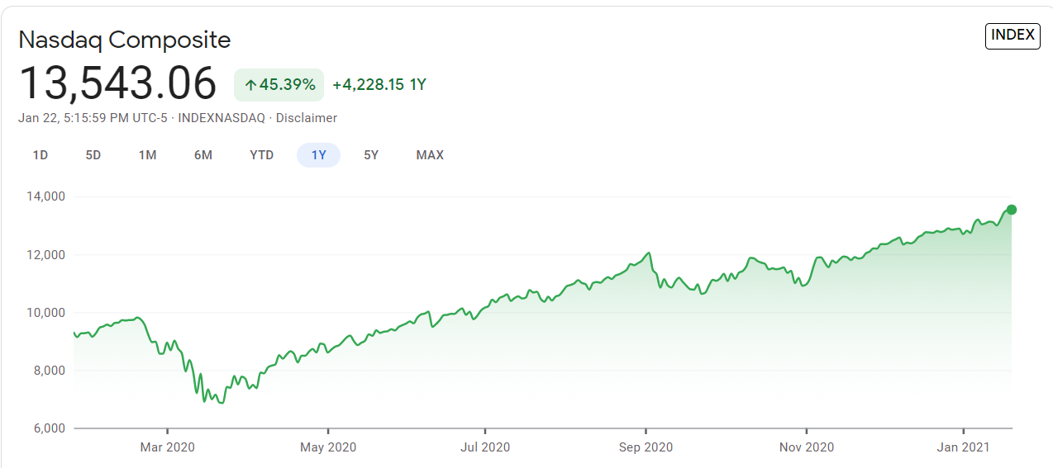
Stock Prices
I wanted to include some data outside of google trends, so I went to Google Finance and pulled the last years stocks for Dow Jones, S&P 500, and Nasdaq
All three are up overall for the year but you can see, they all dropped during the same time frame as flights did when the pandemic fully hit in early 2020
I do not think these have that much to do with flights or even the returning of flying – I think other factors are much more likely to predict flight activity
There are a lot of elements within the last year, such as the presidential election, that can more so affect stock prices as well so they might better reflect other industries
With stock prices I assume that they will not be able to prove or disprove flight activity returning therefore I would not spend much more time in this area

Slide 7
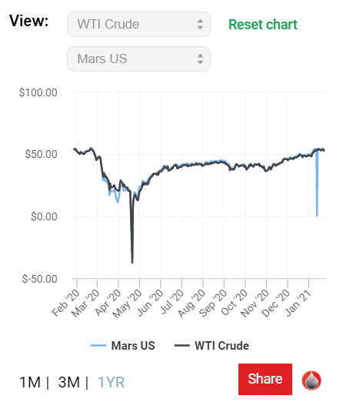
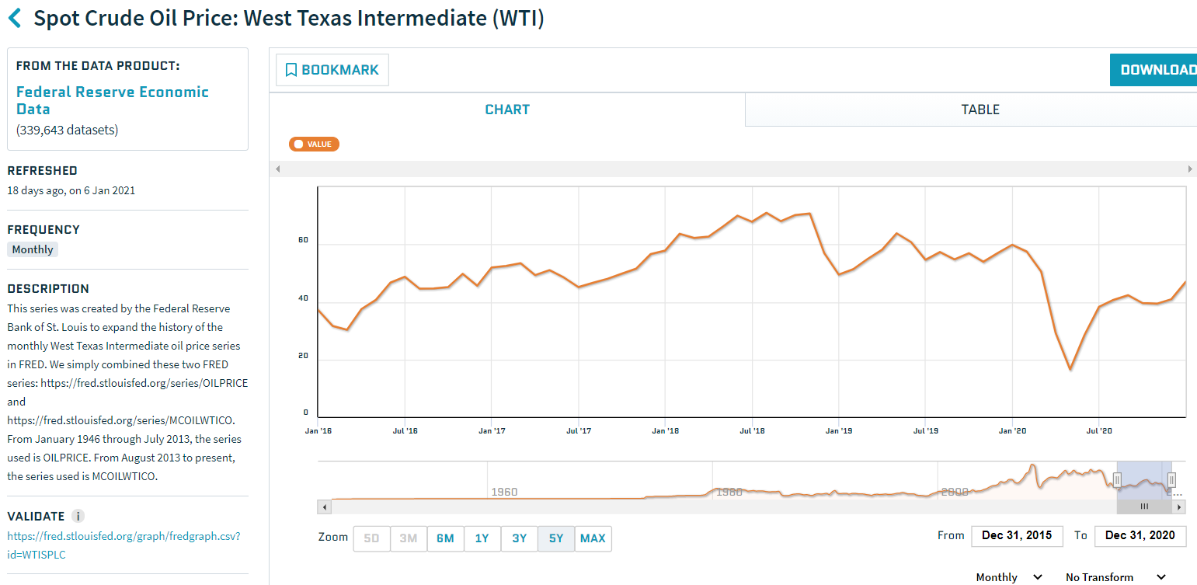
Oil Prices
Another area I looked at outside of Google Trends was US oil prices
I added West Texas Intermediate (WTI) and Mars US oil prices over one year and as you can see, they are very closely related to each other
Oil prices drop around the same time flights drop, and they are starting to grow towards the end of the year
It is hard to tell just buy looking at this chart if oil prices could truly predict flights
I added another chart for WTI that goes back five years to look for an overall trend and it is currently lower than what it has been in the more recent history
I think oil prices have a better chance at being influential on flights than the stock prices, but I would want to do further statistical tests to get a better idea of the possible relationship
With oil prices I can see a possible predictive factor and I assume it would relate to all types of flying. I would want to preform statistical tests to determine if there would be the chance of a negative or positive correlation with flight activity

Slide 8
Next Steps
Ethical Concerns
In addition to the next steps and assumptions I listed on each topic slide I have some general project next steps I would want to do
I think it would be beneficial to purchase flight data – For example, the FAA tracks all flights so I think it would be a great asset to have this data of flights with information on departures, destinations, type, distance, who is flying, and so on
Once I gather all my data from the flight activity source (maybe: FAA), the Google Search data, and Oil Prices data (Quandl provides this data, and more, for free), I would begin data mining implementing the CRISP-DM process
Then I would proceed to the machine learning phase and perform different statistical tests and build models to start answering my question
If I do not find significant results from this set of data I can go back to the beginning and look for more possible indicators
If I was able to purchase data from the FAA or another similar source that included who was making the flights or who owned the aircraft that are flying, then there would be an ethical concern of privacy
I would not want to make public who was flying and would need to make sure that data is stored safely to keep anonymity and to keep it confidential
I would only use such data to get factors to help describe who is flying – personal flying, business flying, industries, etc.
Another ethical concern would be to check my final models for bias and make any changes needed
I would also try to prevent any human bias and I want to make sure whatever I do is transparent
Assumptions
Overall – I assume that I will find factors in the data I have mentioned that will help predict flight activity in the US. I assume the Google Search data will be substantial in proving when or how flight activity will pick back up. I believe general interest in air travel will be described well in Google searches and I think interest in flying through charter companies will also show an increase with this data. I do not have high hopes for stock prices being significant, but I think oil prices might have an influence.

Slide 9
References
Google Finance. (n.d.). Retrieved January 24, 2021, from https://www.google.com/finance
Google Trends. (n.d.). Retrieved January 24, 2021, from https://trends.google.com/trends/?geo=US
Live Flight Tracker - Real-Time Flight Tracker Map. (n.d.). Retrieved January 24, 2021, from https://www.flightradar24.com/data/statistics
Oil Price Charts. (n.d.). Retrieved January 24, 2021, from https://oilprice.com/oil-price-charts/
Spot Crude Oil Price: West Texas Intermediate (WTI). (2020, December 01). Retrieved January 24, 2021, from https://www.quandl.com/data/FRED/WTISPLC-Spot-Crude-Oil-Price-West-Texas-Intermediate-WTI

